Slide 1
Emotion Regulation Task
Participant briefing
We will practice together after this overview

Slide 2
Why We Do This
Learn how people feel when viewing pictures
Your answers help us understand emotions in the brain
There are no right or wrong answers

Slide 3
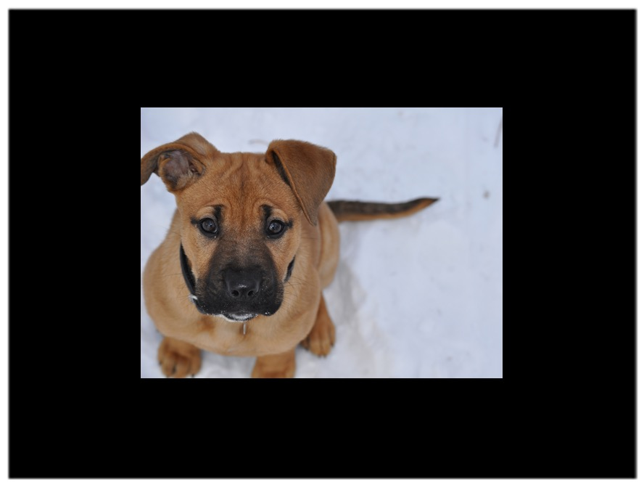
What You Will See
A series of pictures (people, places, everyday scenes)
Some may feel pleasant, unpleasant, or neutral
All reactions are okay

Slide 4
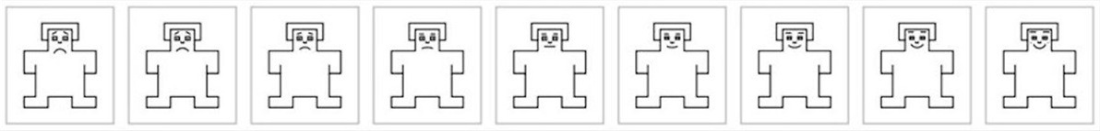
How You Will Respond
After each picture, choose one of nine cartoon figures
Left = very negative, middle = neutral, right = very positive
Press the button that matches how you feel

Slide 5
Two Instruction Types
Feel freely: notice your feelings without changing them
Tone down: try to make feelings calmer and less intense

Slide 6
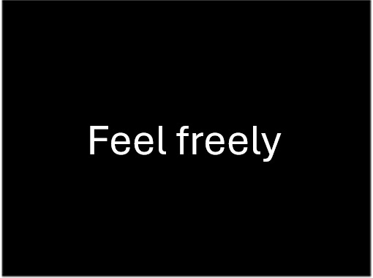
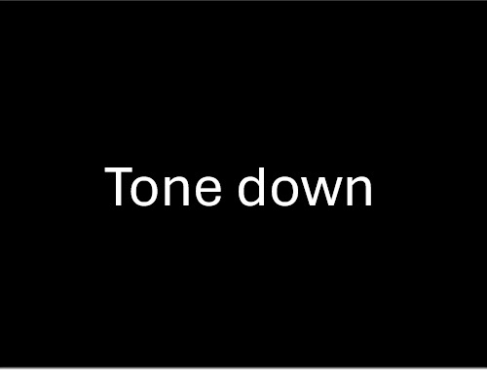
Instruction Screens
You will see one of these before each picture

Slide 7
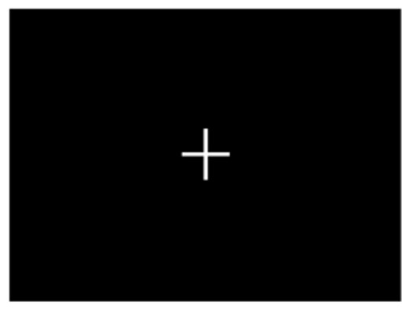
Relax Screen
A cross (+) appears between pictures. Just relax and look at it.

Slide 8
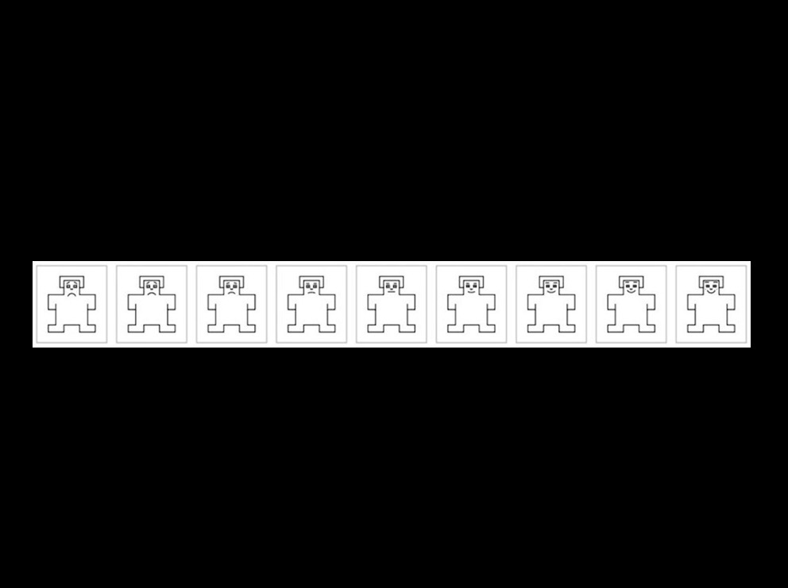
Rating Screen Example
After each picture, choose the figure that matches how you feel

Slide 9
Timing And Breaks
120 images total
4 blocks of 40 pictures (about 5 minutes each)
Break after each block as long as you need
Total task time about 20 minutes

Slide 10
Your Comfort Matters
You can pause, take a break, or stop at any time
Tell us if anything feels uncomfortable
Thank you for helping with this study

